Slide 1
2-bit Microcontroller Design and Build
Prepared by:
Umesh Puri

Slide 2
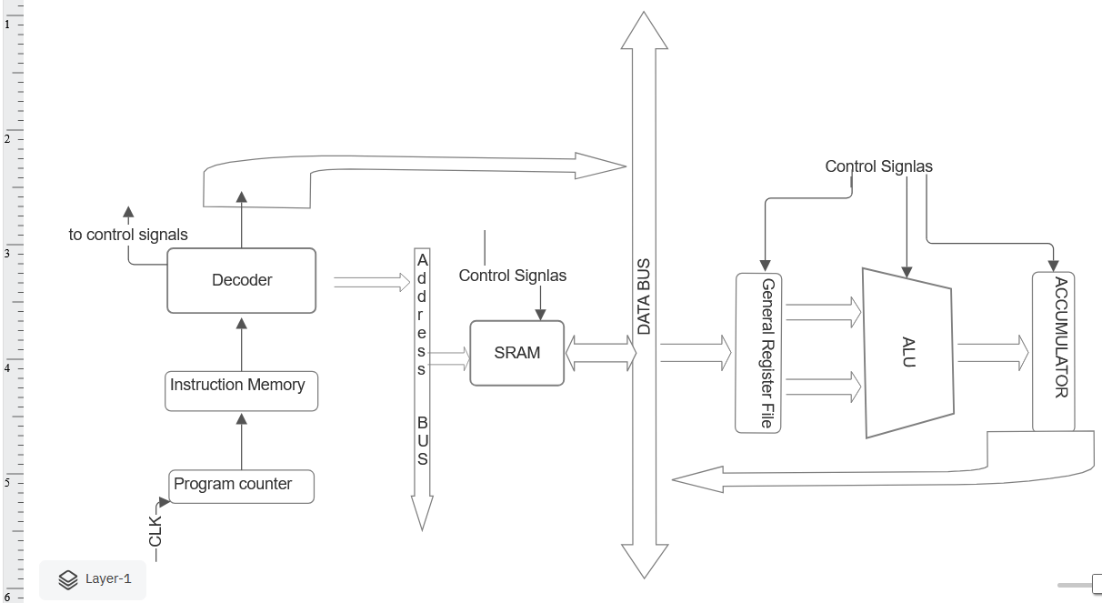
System Architecture Diagram
Is a simple RISC architecture With 2 GPR and 1 ALU RESULT Register

Slide 3
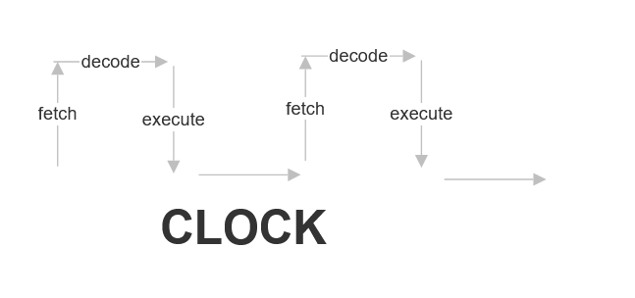
CPU cycle

Slide 4
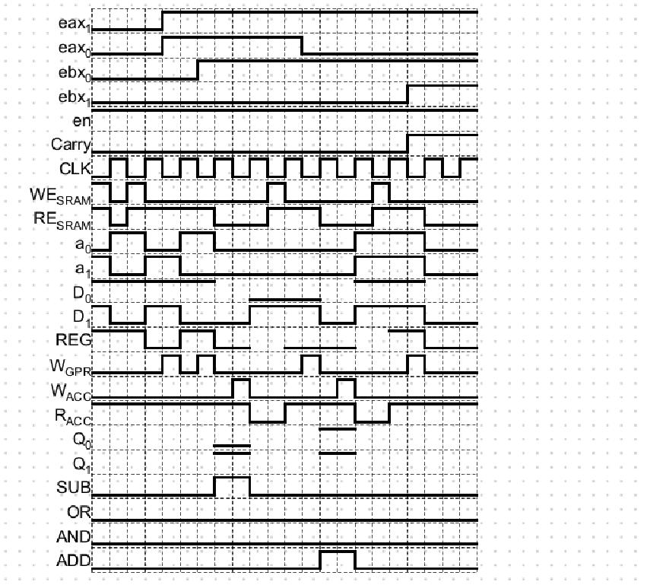
TIMING OF CONTROL AND DATA SIGNALS

Slide 5
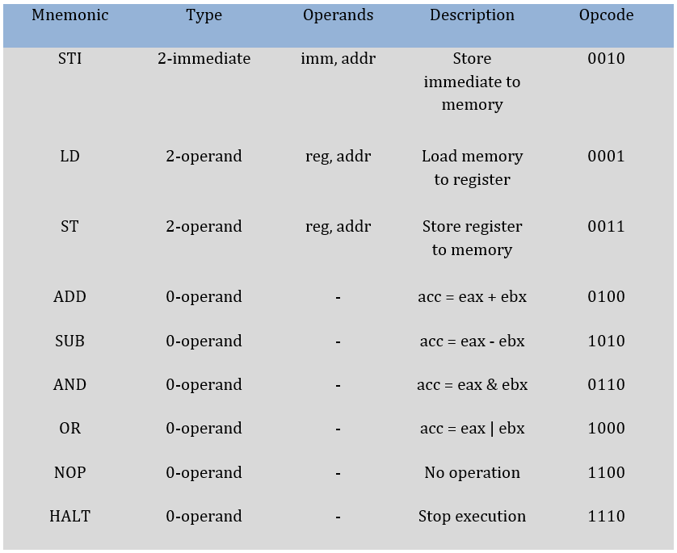
Instruction Set

Slide 6
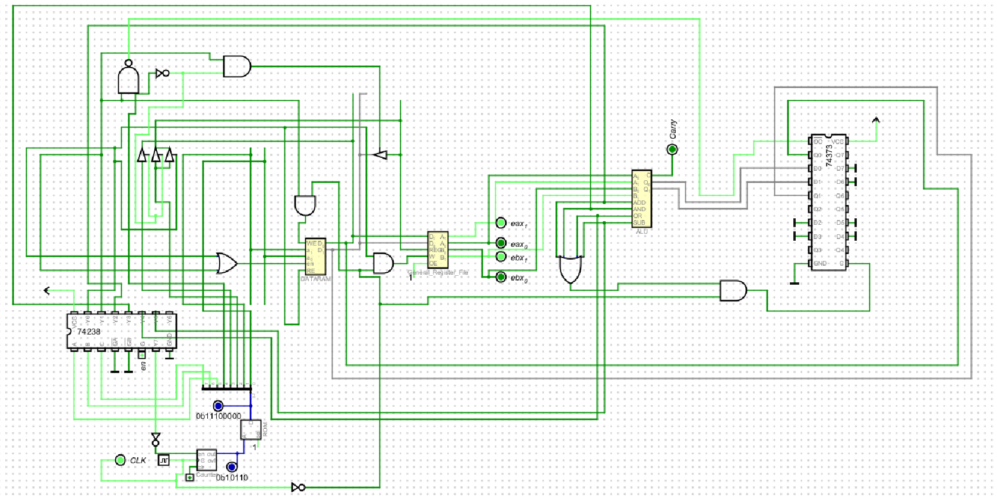
Schematic

Slide 7
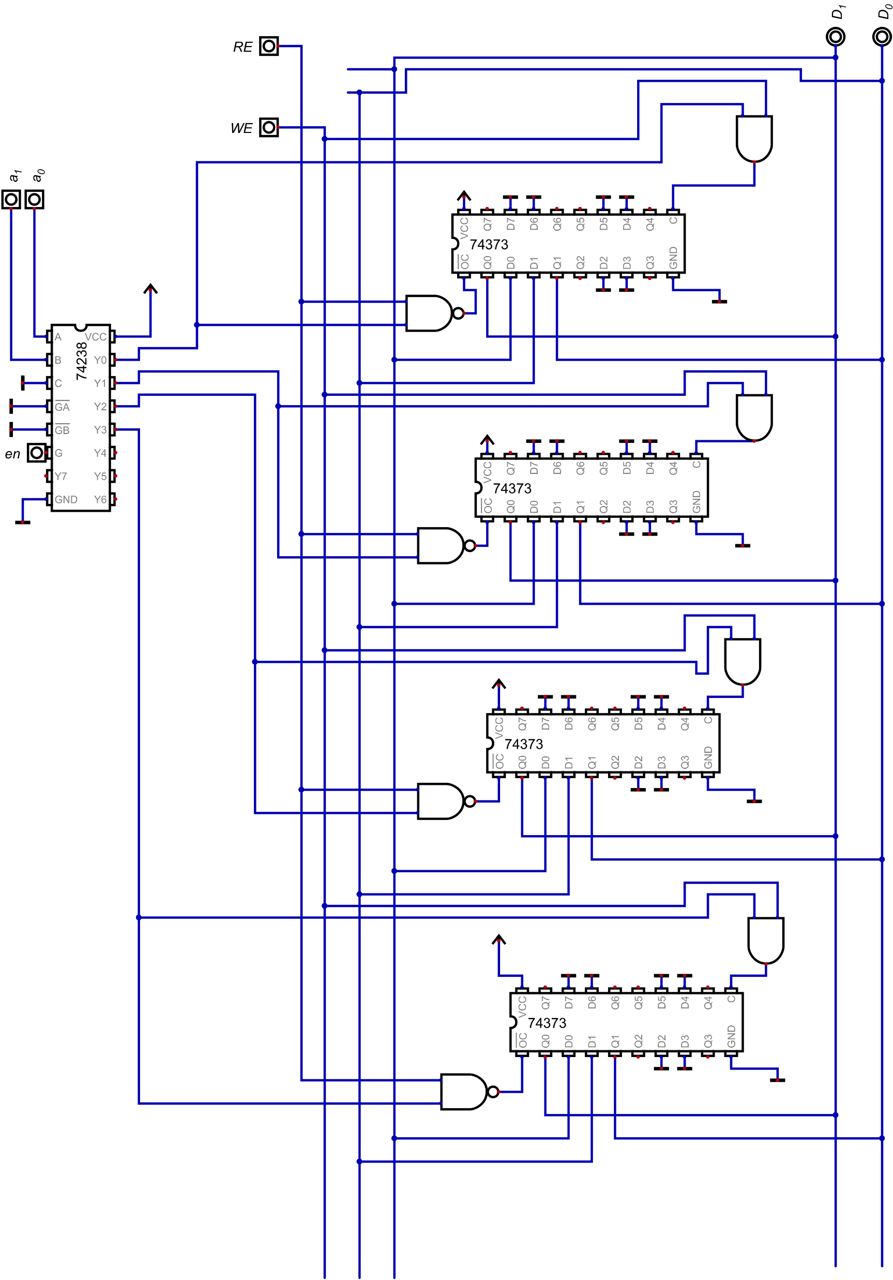
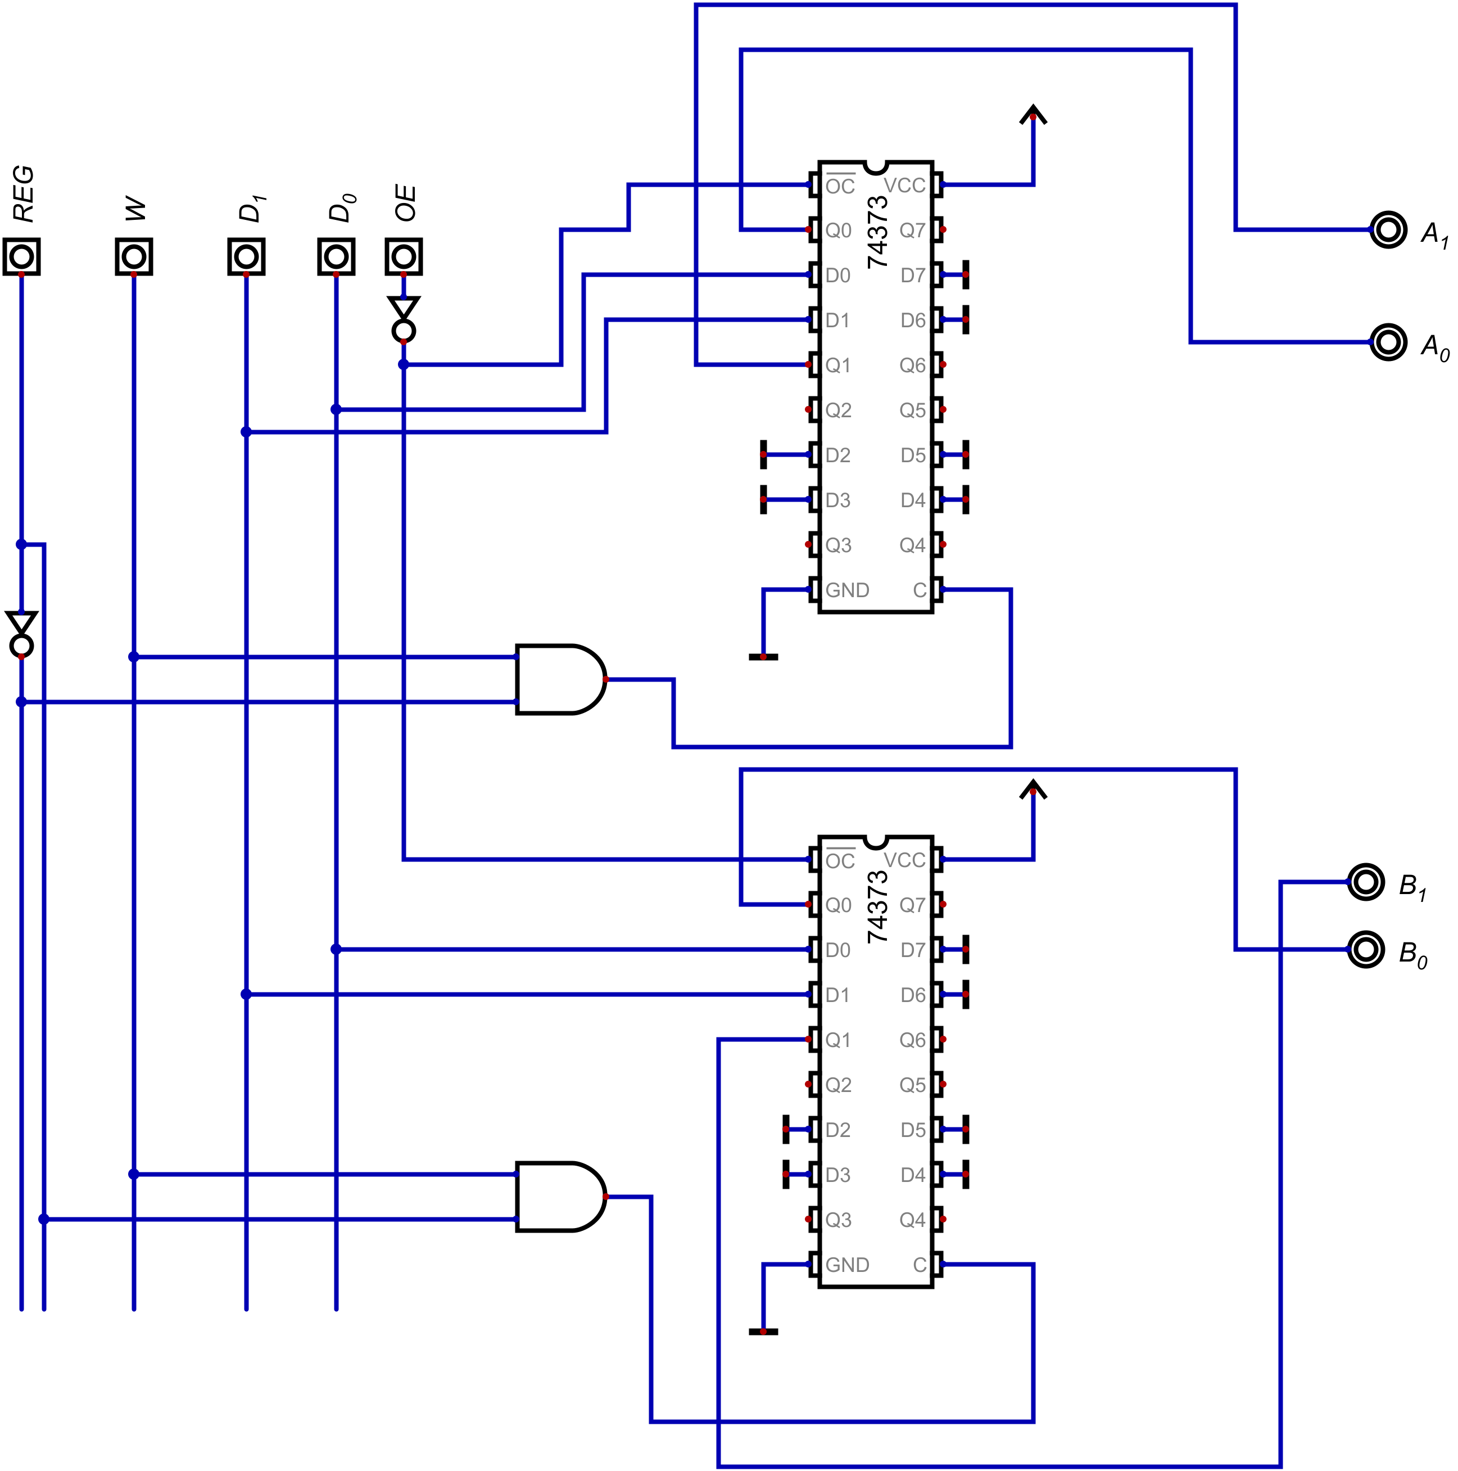
SRAM General Register File

Slide 8
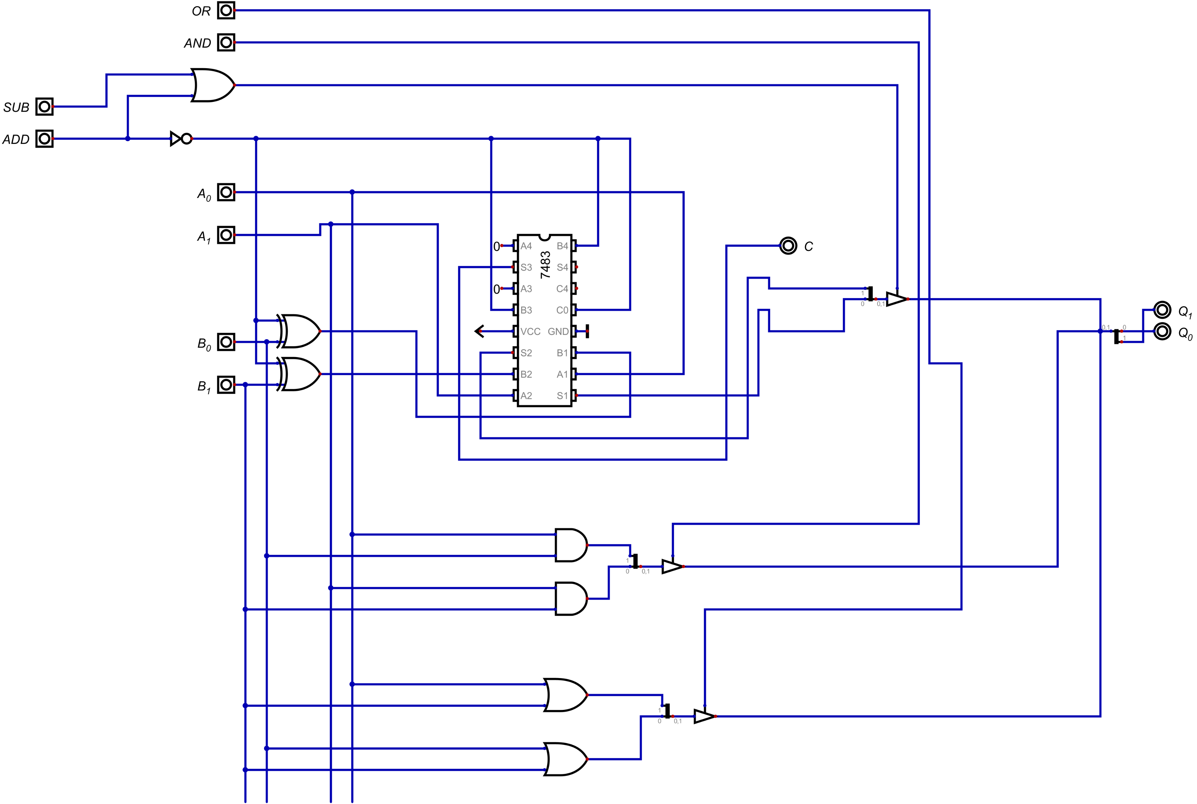
ALU

Slide 9
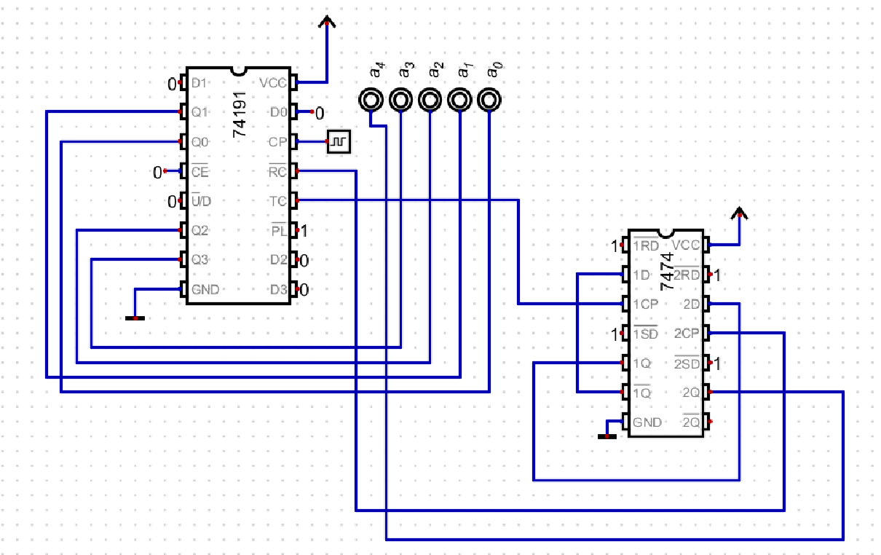
5-bit COUNTER

Slide 10
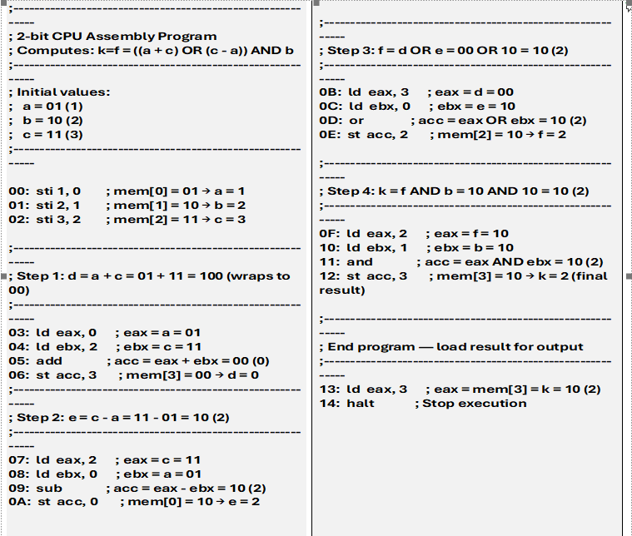
TEST PROGRAM

Slide 11
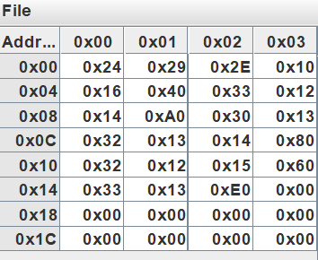
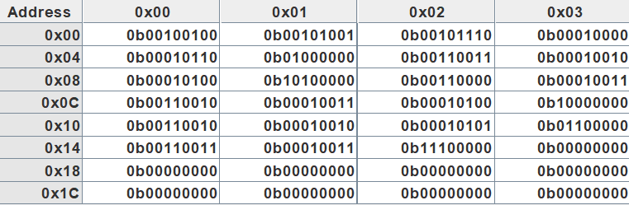
TEST Program(ROM IMAGE)

Slide 12
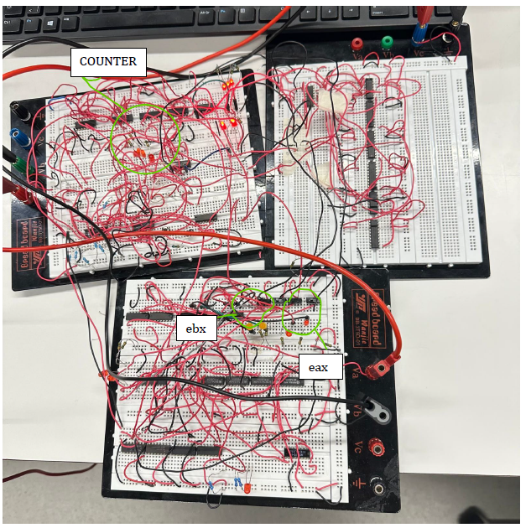
PROTOTYPE

Slide 13
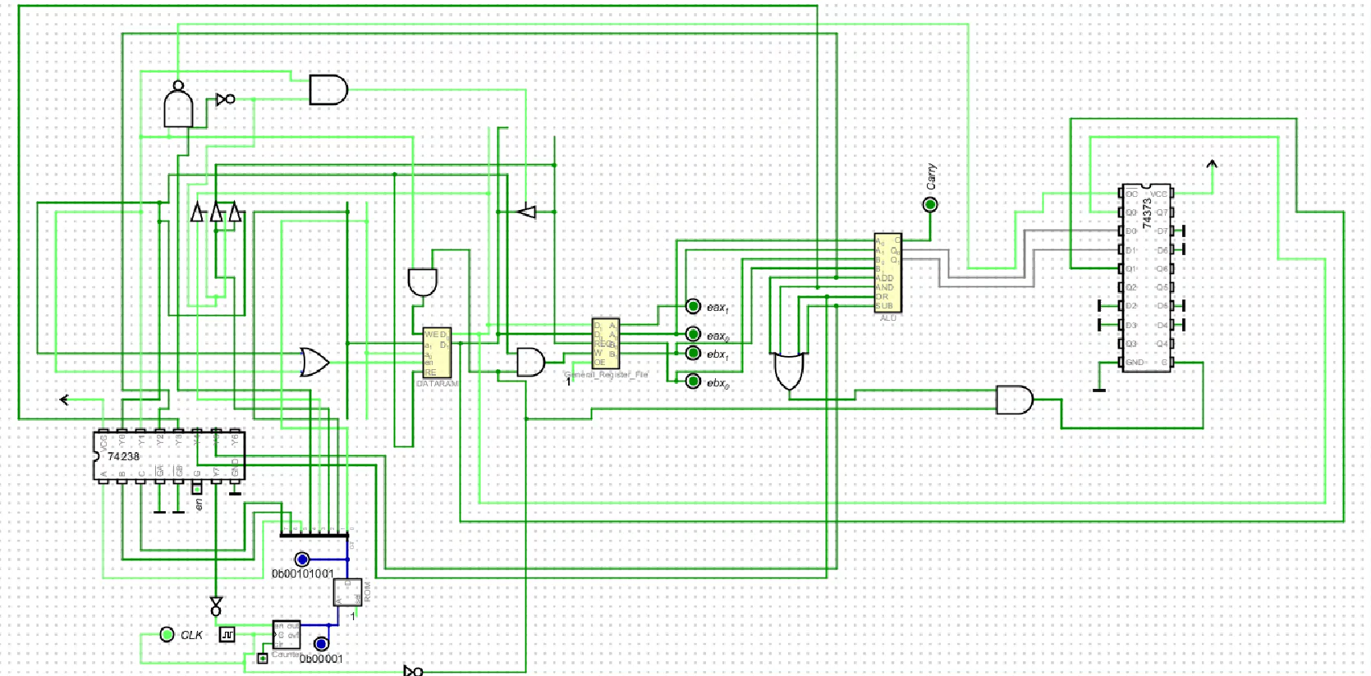
Execution (Simulation)

Slide 14
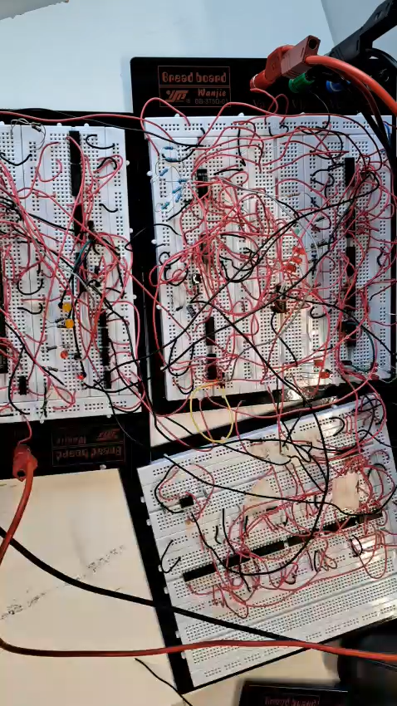
Execution (breadboard)

Slide 15
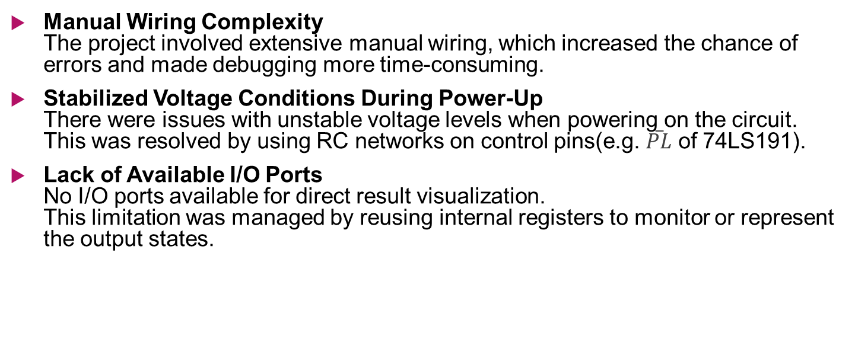
CHALLANGES
Manual Wiring Complexity The project involved extensive manual wiring, which increased the chance of errors and made debugging more time-consuming.
Stabilized Voltage Conditions During Power-Up There were issues with unstable voltage levels when powering on the circuit. This was resolved by using RC networks on control pins(e.g. $\overset{‾}{PL}$ of 74LS191).
Lack of Available I/O Ports No I/O ports available for direct result visualization. This limitation was managed by reusing internal registers to monitor or represent the output states.

Slide 16
FUTURE WORK
Planned improvements: extend to 4-bit or 8-bit data width, add I/O, interrupts, and move to FPGA-based implementation. Add conditional branch/call instructions and add registers to point store and load address register, stack pointer etc to have Program Flow Control to make it Turing complete.
If redone: use PCB design, CMOS logic, and serial ROM/EEPROM programming capability.

Slide 17
Conclusion
The 2-bit ALU microcontroller demonstrates fundamental CPU principles. It replicates the fetch–decode–execute cycle with basic components, providing valuable insights into digital architecture and hardware logic design.

